Slide 1



We use Microsoft in this Council, how does R fit in? Some experiences with officeR in local government.
Oxford R User Group
Dr Douglas Campbell
4th March 2019

Slide 2
Outline
Introduction
The Problem
Acknowledgments
OfficeR
How I currently use OfficeR
Any Questions?

Slide 3
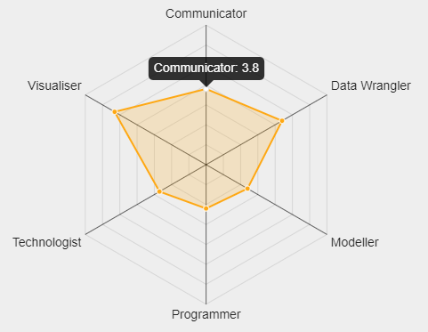
1 Introduction
My routes to R:
1) Small-N problem
- Qualitative Comparative
Analysis solution
- QCA package on R
2) Produce clearer charts
3) What kind of Data
Scientist are you?
https://www.mango-solutions.com/radar/
Notes:
Mention the PhD
Outline the Mango radar – I’m a visualiser

Slide 4



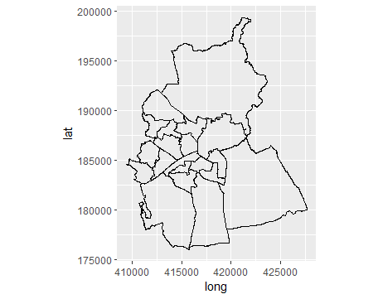






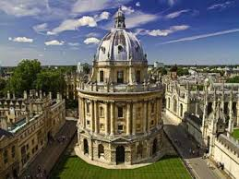

About Swindon
Notes:
An old railway town
220,000 population
Unitary or all purpose council created in 1997.
Wide range of employees
heavy and precision engineering
pharmaceuticals
finance
agencies and academic
007

Slide 5
2 The Problem
How to produce a Word booklet for journalists at the local election count to give some context for each local election unit (wards) and the local authority as a whole (the Borough).
Notes:
Swindon has 57 elected politicians called councillors who serve for 4 years before facing re-election
Elections are by thirds – 19 a year each year for 3 years then a rest.
But, there are 20 wards, 18 with three councillors, 1 with two and one with just one.
Challenge for the script:
aim: to show the results both when the seat was last contested as well as when the ward last had an election
how to pick which of the odd wards is being contested
Is there also a by-election on the same day?
Was there a by-election earlier
I had to create the data sets because they were only on paper or PDF except for the most recent years
This was a high priority request from Members and Comms but low priority for the organisation. because it was not about saving money
It had to be Word so that others could amend it if they so wished

Slide 6
3 Acknowledgements
OfficeR author:
David Gohel
Website
https://davidgohel.github.io/officer/
Notes:
Huge debt to the author for the code and the examples on the website.
Developed from ReporteRs but does not need

Slide 7
4 OfficeR
Installation: CRAN or devtools::install_github(“davidgohel/officer”)
Also install/load:
magrittr
flextable
Notes:
Works with Word, PowerPoint and html, but I have only used it with Word.

Slide 8
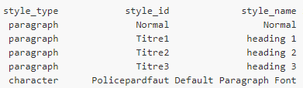
Some Commands in an R Script
my_doc<-read_doc()
body_add_par
body_add_img
body_add_table
body_add_break
body_add_toc
body_add_gg
slip_in_img()
slip_in_seqfield()
slip_in_text()
body_end_section_landscape()
body_end_section_portrait()
body_end_section_columns()
body_end_section_columns_landscape()
body_end_section_continuous()
styles_info(my_doc)
Notes:
Add basic commands
It creates a list
Allows you to add word formatting
Allows you to amend someone else’s document

Slide 9
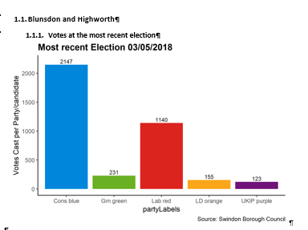
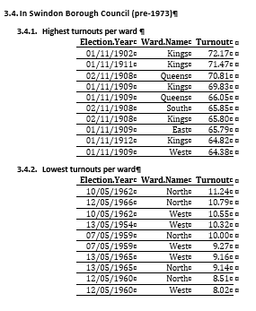
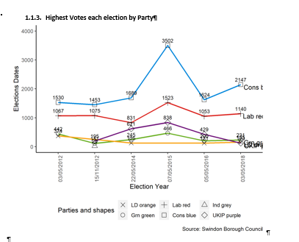
5 How I currently use officeR
Notes:
Example from the program

Slide 10
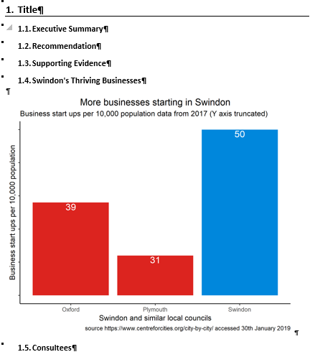
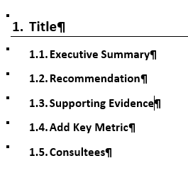
Amending a Word document
Notes:
Example from the program

Slide 11
6 Any Questions

